Slide 1
West Manor Budget Feedback Meeting
To be presented to GO Team BEFORE the school staffing conference

Slide 2
Norms
This is a meeting of the GO Team. Only members of the team may participate in the discussion. Any members of the public present are here to quietly observe.
We will follow the agenda as noticed to the public and stay on task.
We invite and welcome contributions of every member and listen to each other.
We will respect all ideas and assume good intentions.

Slide 3

GO Team Budget Development Process
YOUR SCHOOL STRATEGIC PLAN…
is your roadmap and your role.
It is your direction, your priorities, your vision, your present, your future.
Step 1: Data Review
Step 2: Strategic Plan Review
Step 3: Budget Parameters
(Strategic Priorities)
Step 4: Budget Choices
Notes:
Today I will provide an overview of the budget allocations for FY23. We will begin the work of funding the strategic priorities we agreed upon during our strategic review meeting. (IF YOU HAVE NOT DECIDED ON YOUR PRIORITIES, YOU WILL SAY – WE WILL DECIDE ON OUR PRIORITIES AND THEN DISCUSS ALLOCATING FUNDS TO ADDRESS THOSE PRIORITIES).

Slide 4
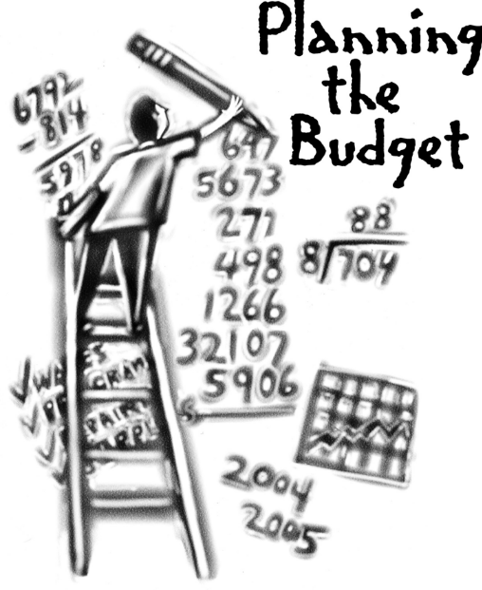
Overview of FY ‘24 GO Team Budget Process
Step 1 Review and Update Strategic Plan and Rank Strategic Priorities
By end of Fall Semester
Step 6 Principals: HR Staffing Conferences Begin
Late February – Early March
Step 3 GO Team Initial Budget Session: Allocation
January 24 – early February
Step 7 GO Team Final Budget Approval Meeting
Budgets Approved by March 17
Step 5
GO Team Feedback Session: Draft Budget Presented & Discussed February – multiple meetings, if necessary
Step 4 Principals: Associate Supt. Discussions and Review
February (supports needed, specific challenges, coaching)
Step 2 Principals: Workshop FY 24 Budget
January 24
GO Teams are encouraged to have ongoing conversations

Slide 5
Budget Feedback Meetings
What
The GO Team feedback session(s) should be scheduled for the principal to provide an overview of the school’s draft budget for the GO Team members and the general public.
Why
This meeting provides an opportunity for GO Teams to discuss how the school’s budget has been allocated to support the programmatic needs and key strategic priorities.
When
Meetings must be held in February before staffing conferences. May be combined with the allocation meeting (as needed), if the GO Team has completed strategic plan updates and ranked strategic priorities.
Notes:
Looking for general consensus prior to Staffing Conferences

Slide 6

FY24 Budget Parameters
FY24 School Priorities | Rationale
Improve percent of students achieving at proficient level on Milestones assessment | Provide instruction to prepare students for their next educational level and remove instructional gaps caused by Covid
Implement International Baccalaureate program model | Provide rigor and ensure our students think globally
Ensure a welcoming parent friendly environment | increase parent involvement to strengthen the partnership between school and home
Notes:
Review the priorities that the GO Team has developed and the rationale for these priorities. Feel free to copy this slide if you have more than 3 priorities to account for.

Slide 7
Descriptions of Strategic Plan
Breakout Categories
Priorities: FY24 funding priorities from the school’s strategic plan, ranked by the order of importance.
APS Five Focus Area: What part of the APS Five is the priority aligned to?
Strategies: Lays out specific objectives for schools improvement.
Request: “The Ask” What needs to be funded in order to support the strategy?
Amount: What is the cost associated with the Request?

Slide 8
FY24 Strategic Plan Break-out
Priorities | APS FIVE Focus Area | Strategies | Requests | Amount
Create an intervention block to remediate skills introduced during virtual instruction | Curriculum and instruction Personalized Learning | Daily intervention block of 45 minutes in the areas of Math and Literacy twice weekly | Adjust master schedule | Stipend paid by district
Increase proficiency on Milestones and remediated skills | Curriculum and instruction Data | Create full time Response to intervention teacher for student support and progress monitoring | Purchase fulltime SST Teacher | 109,000
Implement International Baccalaureate program | Signature Programs Data | Conduct professional development of teachers and meet program requirements | Hire Full Time IB Coordinator | 109,00
Increase Family Engagement | Whole child Data | Conduct parent training sessions and improve communication of events and how to assist students | Hire Full Time Parent Liaison | 49,000
Decrease the number of students with ten or more days absent and support families | Whole child | Create attendance and Care Teams to support parents and remove barriers for attendance | Hire a full time Social Worker and Nurse | 150000
Notes:
For the next few slides, I will show you how I have allocated the budget to support our strategic priorities.
Based on our strategic priorities and funds we received, here is a break-out of the priorities, which focus area it addresses, the strategies that will be implemented, the purchase request, which funding source was used and the amount.

Slide 9
Plan for FY24 Leveling Reserve
Priorities | APS FIVE Focus Area | Strategies | Requests | Amount
Increase student proficiency In literacy and numeracy | Curriculum and instruction Data Personalized Learning | Provide resources and assist with instruction of students | provide manipulatives, web-based programs and resources to support student learning | 51,000
Notes:
For the next few slides, I will show you how I have allocated the budget to support our strategic priorities.
Based on our strategic priorities and funds we received, here is a break-out of the priorities, which focus area it addresses, the strategies that will be implemented, the purchase request, which funding source was used and the amount.

Slide 10
Plan for FY24 Title I Holdback & Family Engagement Funds
Priorities | APS FIVE Focus Area | Strategies | Requests | Amount
Increase parental engagement and student attendance | Whole child | Provide incentives for attendance and participation in school activities | Purchase incentives for students meeting attendance target | 6,000
Notes:
For the next few slides, I will show you how I have allocated the budget to support our strategic priorities.
Based on our strategic priorities and funds we received, here is a break-out of the priorities, which focus area it addresses, the strategies that will be implemented, the purchase request, which funding source was used and the amount.

Slide 11
Plan for FY24 CARES Allocation
Priorities | APS FIVE Focus Area | Strategies | Requests | Amount
Keep class sizes small to increase direct instruction | Curriculum and instruction Data Personalized instruction | Small class sizes allow for individual attention to student needs and time to forces on individual gaps | Hire a Teacher to decrease class size on large grade level | 109,000
Increase student achievement | Curriculum and instruction Personalized instruction | Implement I Ready learning Paths for students | Purchase I Ready web-based program and resources | 16000
Address student gaps in instruction due to the pandemic | Curriculum and instruction Data Personalized instruction | Implement Student Support Program with Fidelity | Increase SST Teachers from half time to full time employment | 49,000
Notes:
For the next few slides, I will show you how I have allocated the budget to support our strategic priorities.
Based on our strategic priorities and funds we received, here is a break-out of the priorities, which focus area it addresses, the strategies that will be implemented, the purchase request, which funding source was used and the amount.

Slide 12
Budget by Function
*Based on Current Allocation of School Budget
School | West Manor Elementary School
Location | 2569
Level | ES
Principal | Reginald Lawrence
Projected Enrollment | 266
Total Budget | $4,132,707
Account | Account Description | FTE | Budget | Per Pupil
1000 | Instruction | 26.05 | $2,614,474 | $9,829
2100 | Pupil Services | 3.75 | $305,936 | $1,150
2210 | Improvement of Instructional Services | 2.00 | $228,285 | $858
2213 | Instructional Staff Training | - | $- | $-
2220 | Educational Media Services | 1.00 | $106,646 | $401
2400 | School Administration | 3.00 | $377,374 | $1,419
2600 | Maintenance & Operations | 1.50 | $84,674 | $318
Notes:
I am passing out the definitions for these funding categories. You will see what makes up each category. Although the school’s total budget amount will not change, allocation per function may change depending on our conversations and school needs.

Slide 13
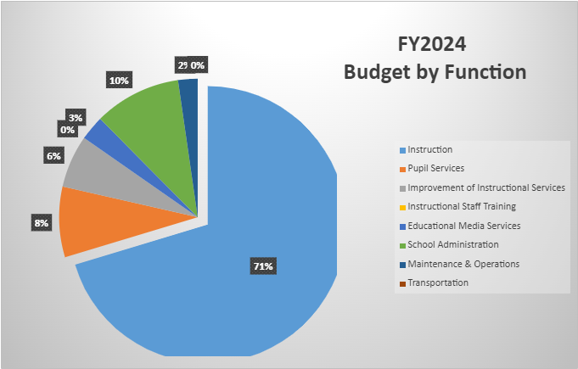
Budget by Function
*Based on Current Allocation of School Budget
Notes:
Explain the pie chart and allocations

Slide 14
Questions for the GO Team to Consider and Discuss
Are our school’s priorities (from your strategic plan) reflected in this budget?
Are new positions and/or resources included in the budget to address our major priorities?
Do we know (as a team) the plan to support implementation of these priorities beyond the budget (ex. What strategies will be implemented)?
What tradeoffs are being made in order to support these priorities?
How are district and cluster priorities reflected in our budget?
Cluster priorities- what staff, materials, etc. are dedicated to supporting our cluster’s priorities?
Signature programs- what staff, materials, etc. are dedicated to supporting our signature program?
Are there positions our school will share with another school, i.e. nurse, counselor?
Notes:
CHAIR - Our final task for today! Here are questions that we need to consider to ensure we have a good working draft budget. Let’s walk through them together.

Slide 15
Where We’re Going?
Our next meeting is the Budget Approval Meeting
What:
During this meeting we will review the budget, which should be updated based on feedback from the staffing conference, Associate Superintendents, and key leaders. After review, GO Teams will need to take action (i.e., vote) on the FY24 Budget.
Why:
Principals will present the final budget recommendations for GO Team approval.
When:
All approval meetings must be held after staffing conferences. Budgets must be approved by March 17th.

Slide 16
Thank you

